Slide 1
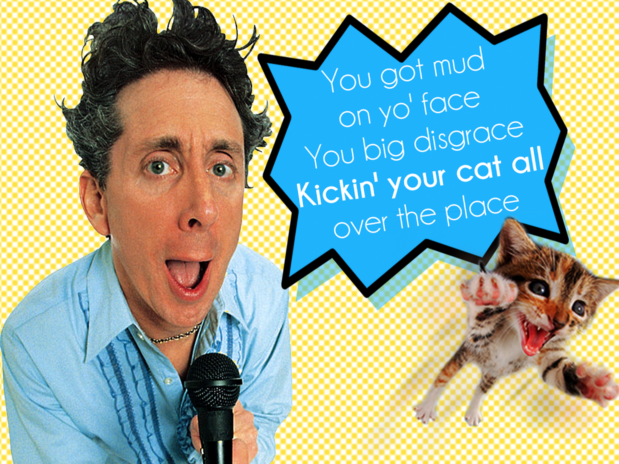

Slide 2
I hate it when
I’m singing a song
and the artist
gets the words wrong.

Slide 3
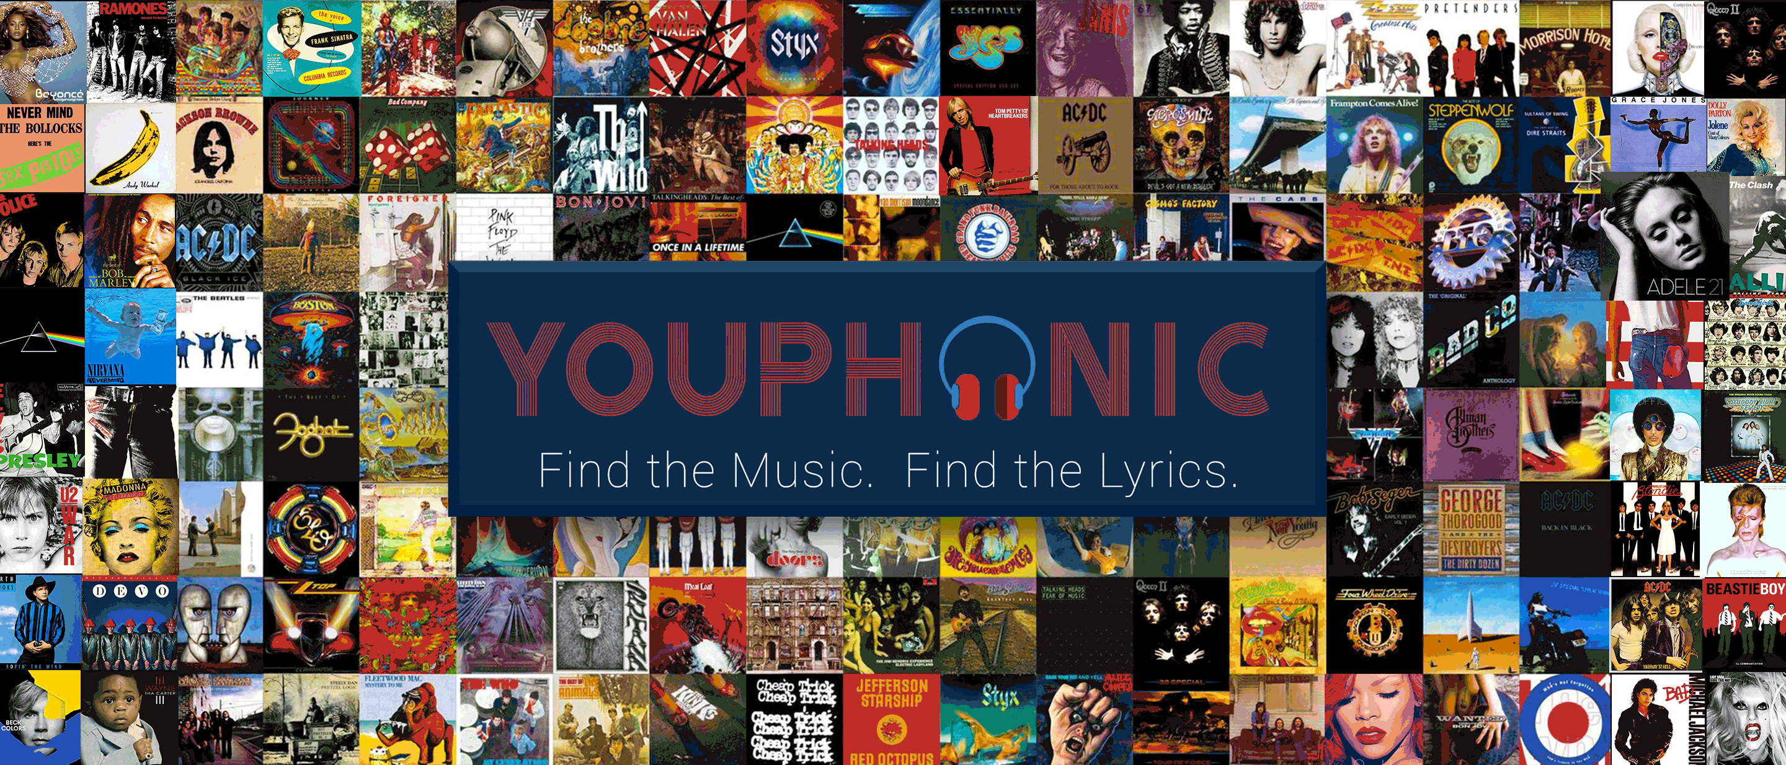
our team
Samantha Olvera
MusixMatch API
Jamar Parham
YouTube API
Kimberly Swope
Front End
Patrick Francis
YouTube API/MusixMatch API

Slide 4
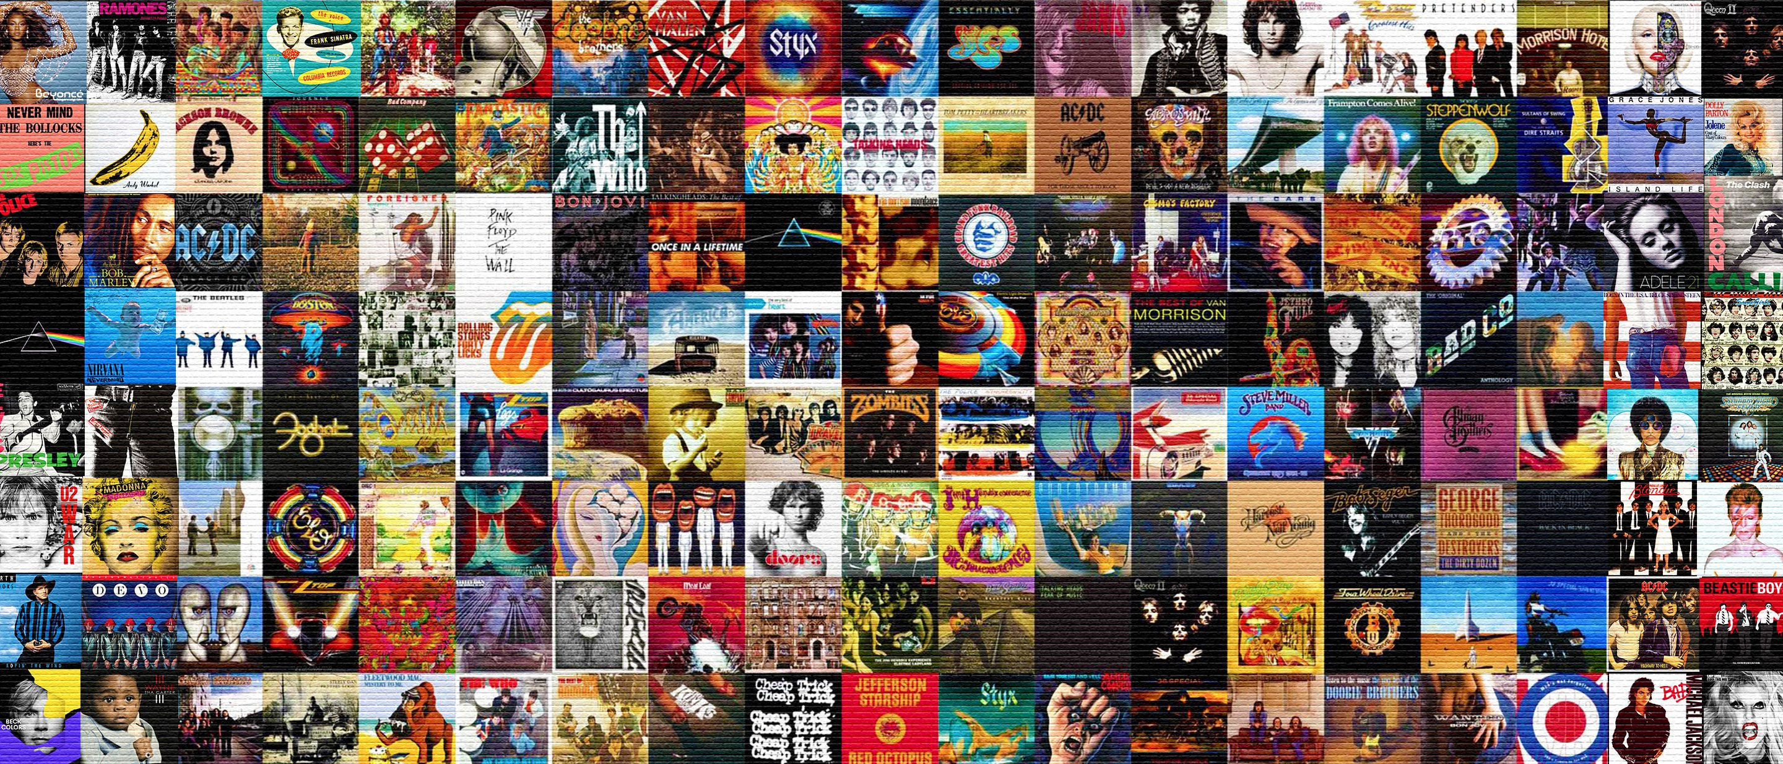

Application Concept
An application that allows the user to find a selected YouTube song video and provide the accompanying lyrics with MusixMatch.

Slide 5

The motivation for its development
Motivation
We wanted a fun idea that wasn’t very complex.
Help those who are lyrically challenged.

Slide 6
Design Process
Search API’s
Find 2 that would work well together
Decide on application idea
Wire-frame front end
Decide on tasks - front and back end
Research API documentation
Code
Integrate front and back end
Test/Debug
Design tweaks
Launch

Slide 7
The technologies you used (and briefly how they work)
Technology Utilized
YouTube Data API v3
MusixMatch API
JavaScript Client Library
Bootstrap/CSS/HTML

Slide 8
Demonstration

Slide 9
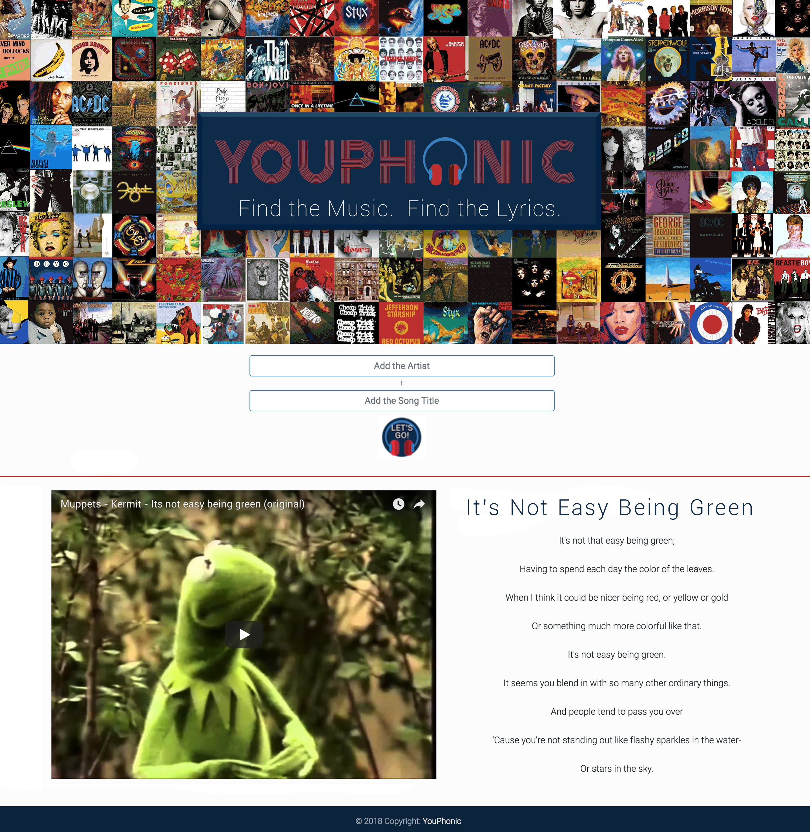

Slide 10
Features
User friendly
Purposeful
Adaptive
User Focused

Slide 11
Future Development
Find a different API that allows full lyric access
Get the lyrics to scroll and styled appropriately
Utilize branded “error” modal for undeliverable searches
Add more Karaoke features using instrumental YouTube search with scrolling lyrics
Utilize lyric timer for Karaoke Feature

